Slide 1

Laser Cat
Presented by:
Almeda Glenn Brandon Tan Troy Toh Lim Wei Heng

Slide 2
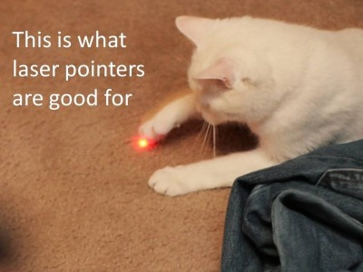
Notes:
Appetizer slides

Slide 3
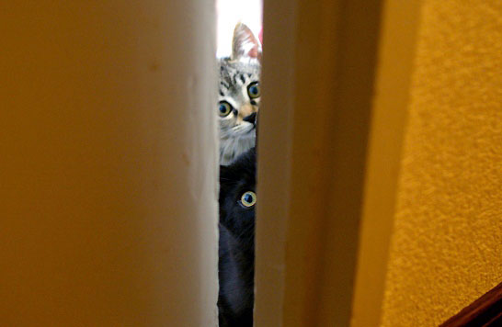
Overview
Our Tasks
Project Schedule
Screenshots (Before & After)
Gameplay Samples
Risks/Concerns
Random Inspirations
Notes:
Who says what must be mentioned here

Slide 4
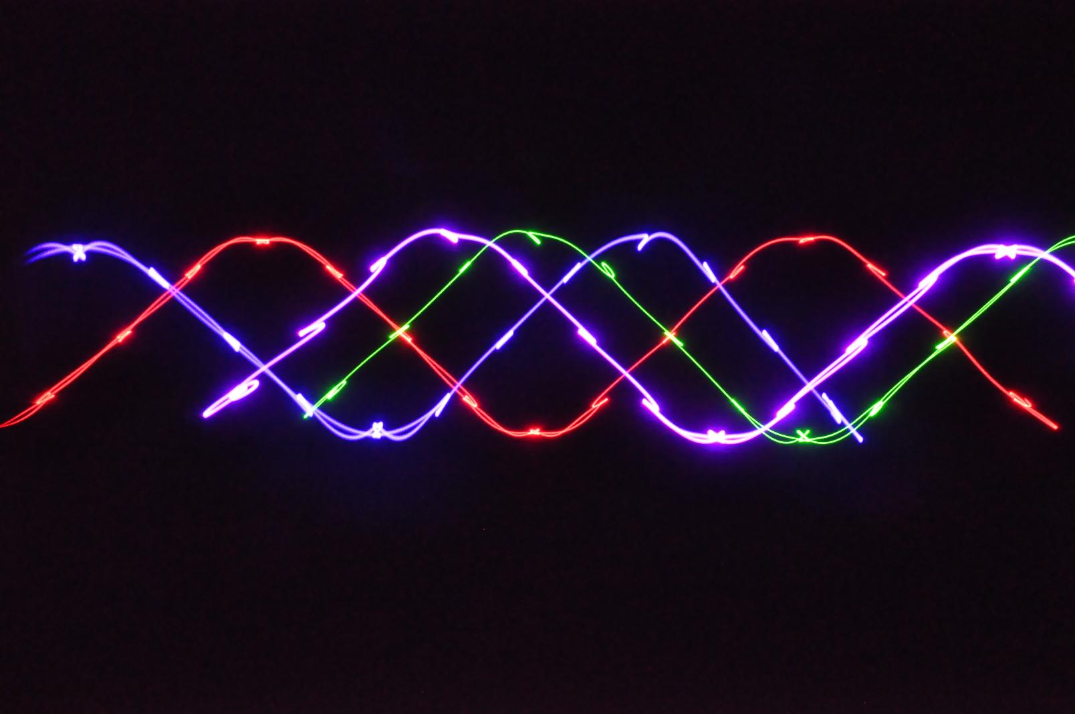
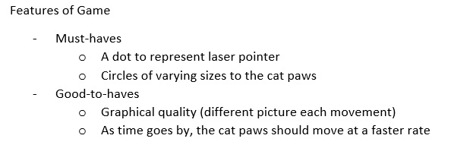
Our Tasks

Slide 5
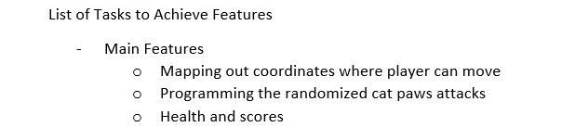
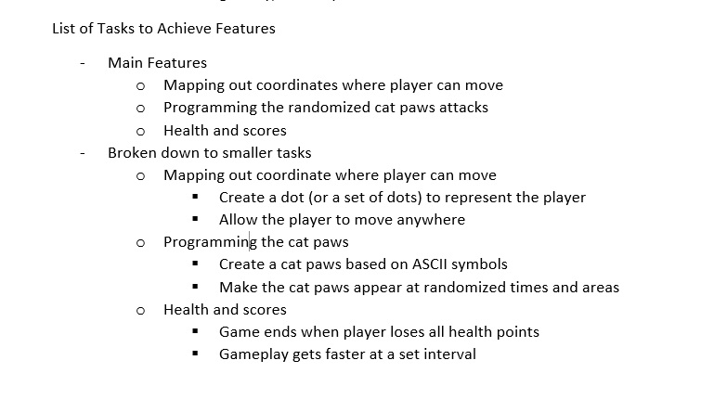
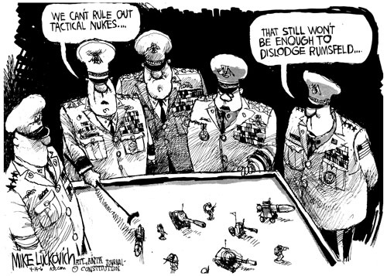
Our Tasks

Slide 6
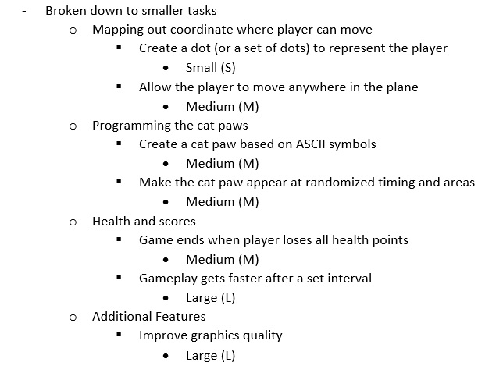
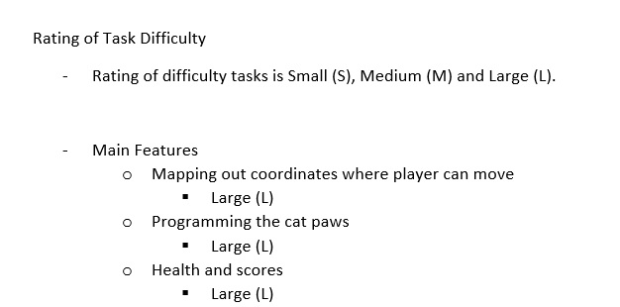

Our Tasks
Notes:
Small < 10 hours, Medium = 10 < x < 20, Large >20 hours

Slide 7

60 hours!!!
Notes:
Minimum number of hours collectively…

Slide 8
So…
Notes:
Add in a picture of your choice (Troy)

Slide 9
Who did what?
Glenn – Documentation Lead/Play-Tester
Troy – Programmer Assist/Documentation Assist
Brandon – Game Programmer Assist
Wei Heng – Game Programmer Lead
Notes:
So who did what?

Slide 10
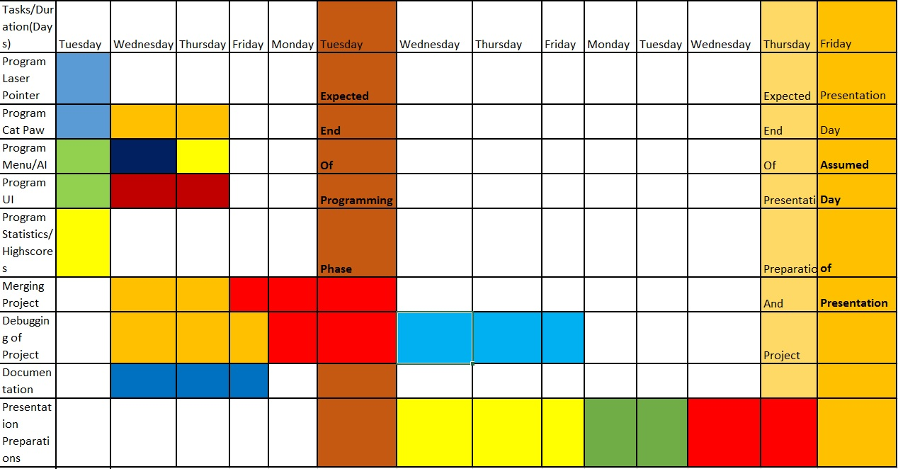
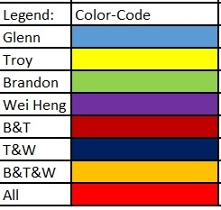
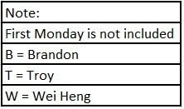
Original Project Schedule
Notes:
Confident that we can finish in two weeks..

Slide 11
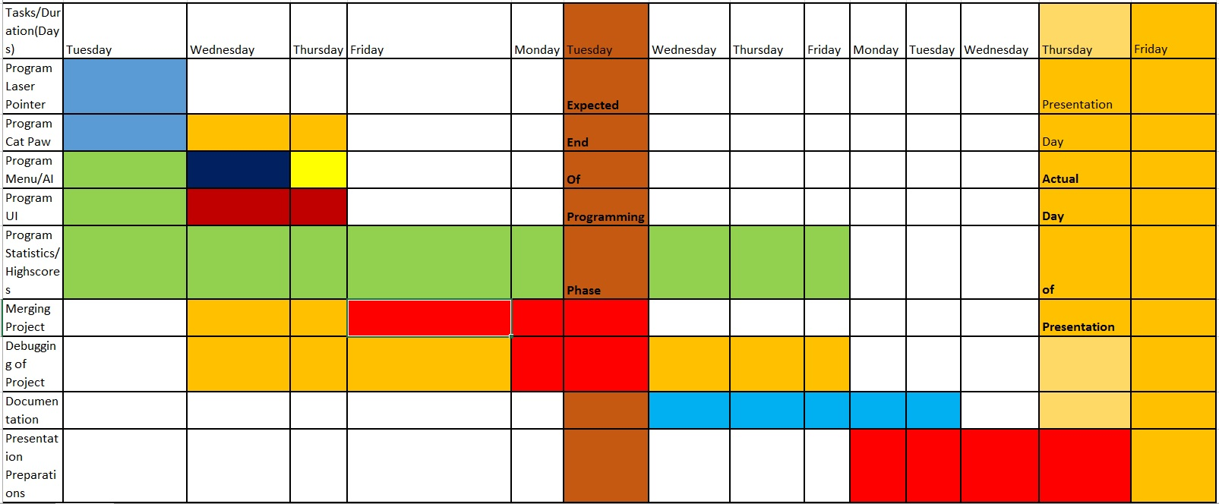
Actual Project Schedule
Notes:
We underestimated a few tasks…lots of optimisation process and highscores problems

Slide 12
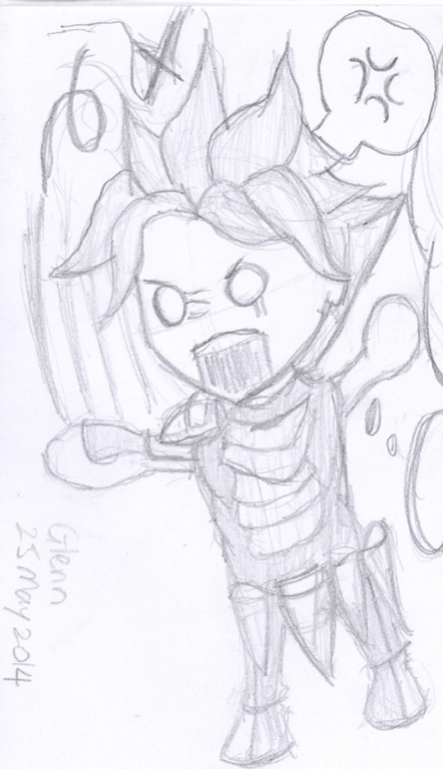
Moving on…
Notes:
Transition cue

Slide 13
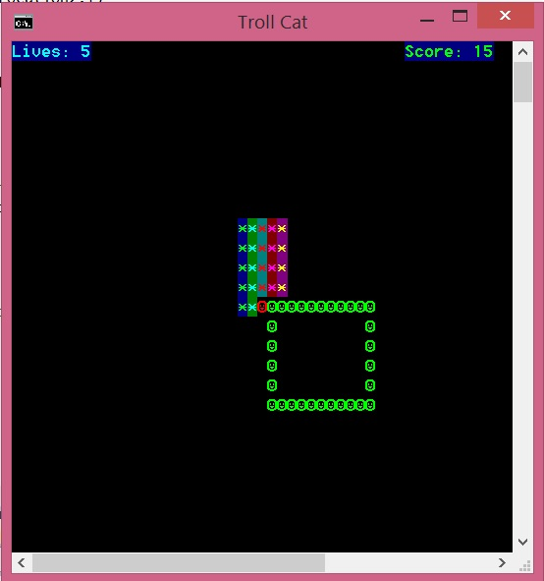
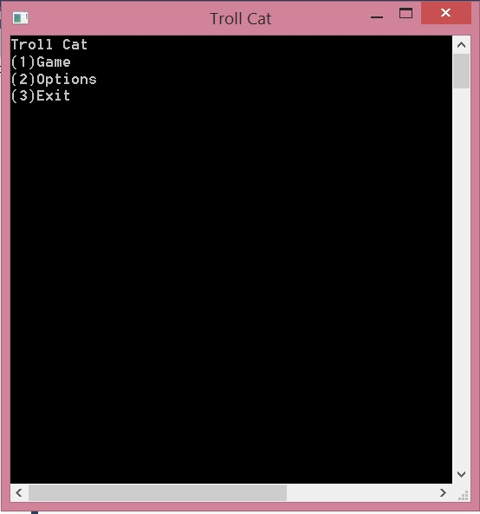
Screenshots (Before)
Initial Menu →
← Initial Gameplay
Notes:
What it looked like when we first started

Slide 14
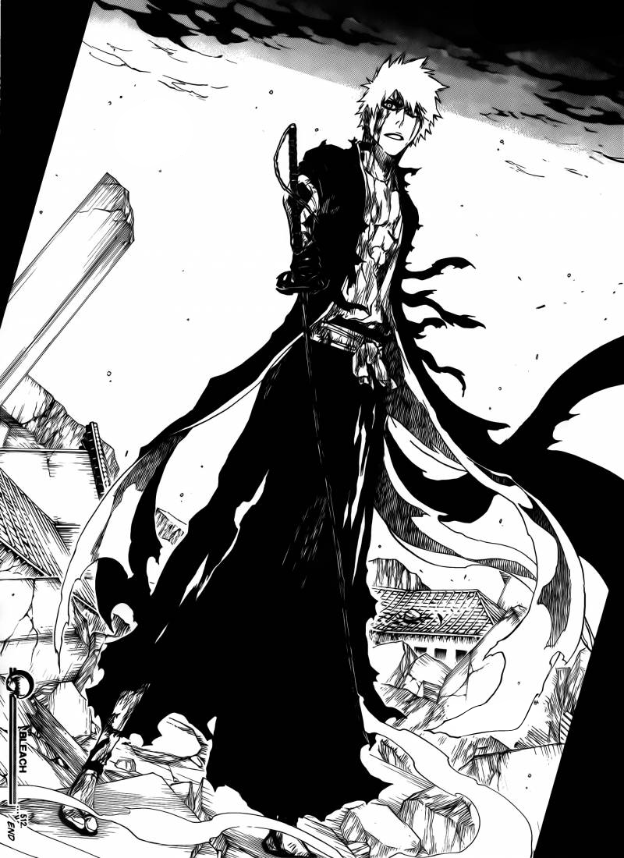
After much work…

Slide 15
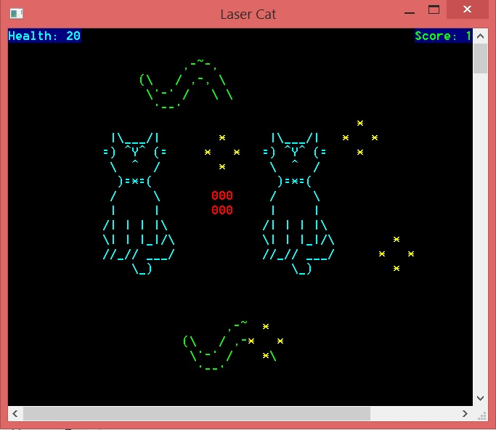
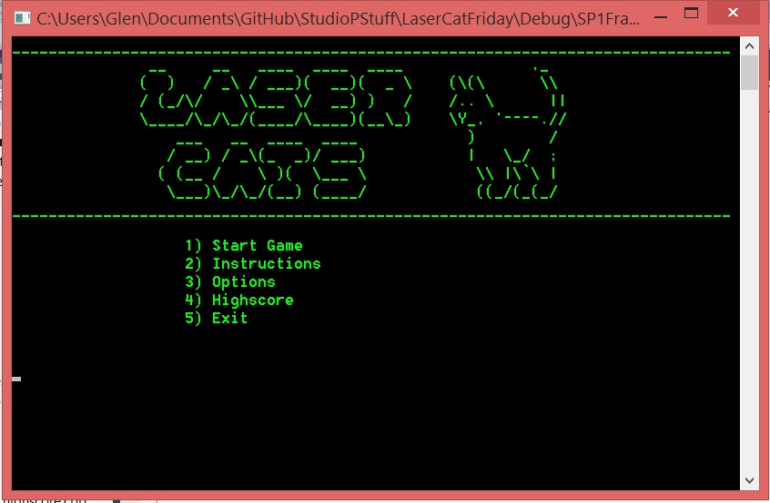
Screenshots (After)
Final Menu →
← Final Gameplay
Notes:
Final outlook

Slide 16
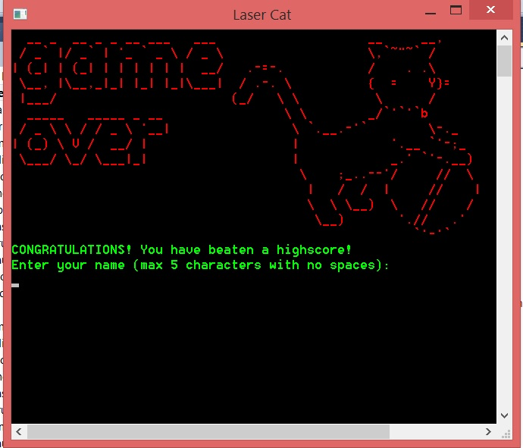
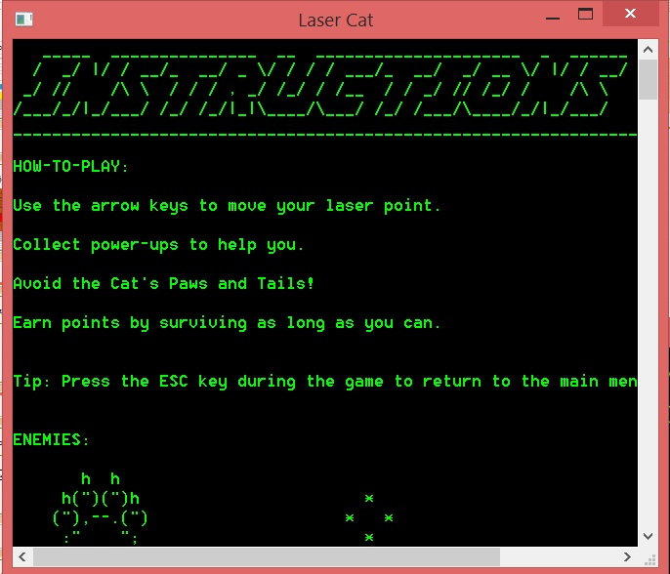
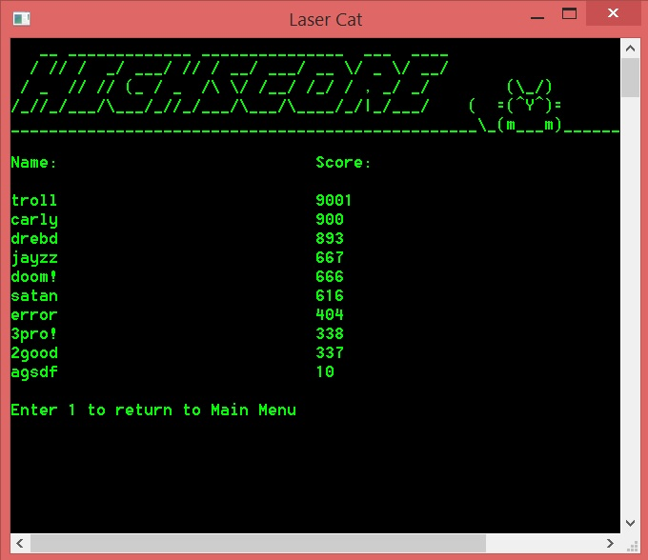
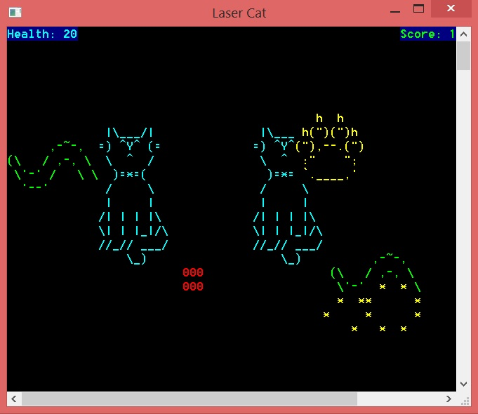
Gameplay Samples
Notes:
Some more samples of our gameplay

Slide 17
But then…
Notes:
Add in a picture of your choice (Brandon)

Slide 18

Risks/Problems/Concerns
Perceived lack of reflexes
Unseen bugs in the gameplay
Notes:
Points that we considered during the project

Slide 19
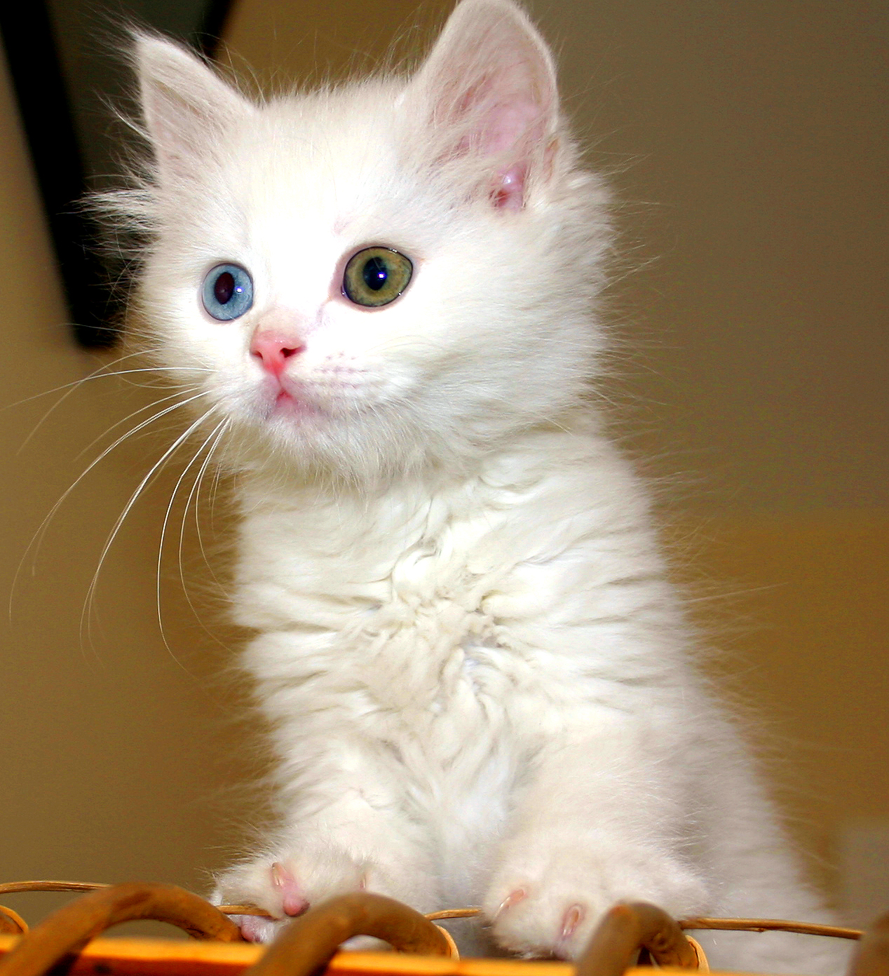
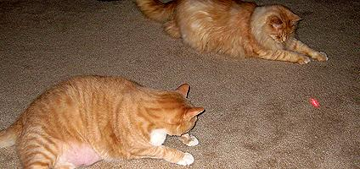
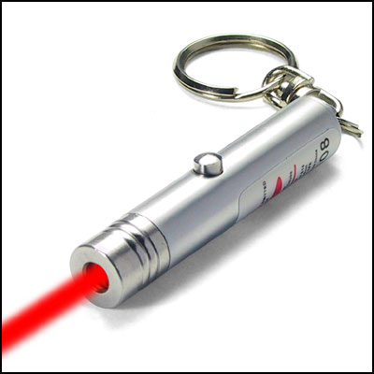
Inspirations
Notes:
Where we got our inspirations from

Slide 20
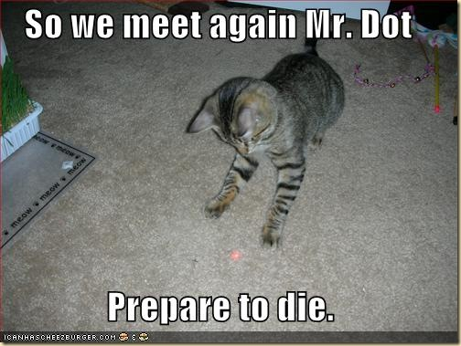

Slide 21
Credits
References for the pictures in this presentation:
Marvel Cyclops (1st slide) - http://images5.fanpop.com/image/photos/29000000/Cyclops-x-men-29088946-1024-768.jpg
1st cat chase laser (2nd slide) - http://2vga1o5mew51s6gu7x0mnk7kf.wpengine.netdna-cdn.com/wp-content/uploads/main/2013_06/White-Cat-Chasing-Laser.jpg
Cat behind door (3rd slide) - http://lovemeow.com/wp-content/uploads/2011/06/20110531102513fa8.jpg

Slide 22
Credits
Laser Waves (4th slide) - http://www.studiodopey.nl/wp-content/uploads/2014/01/650mw-Rgbp-Four-Tunnel-Laser-DJ-Light-Disco-Lighting-Club-Light-D650RGBP-.jpg
Generals planning (5th slide) - http://www.truthdig.com/images/cartoonuploads/five_generals_500.jpg
Whistle (6th slide) - http://hiroku.files.wordpress.com/2008/11/f3-small.jpg?w=490

Slide 23
Credits
Angelic Buster (Maplestory) (7th slide) - http://media.playpark.net/MapleStory/uploadimages/Angelic_Adoration_Chair_Magic_Carpet_Mount.png
Ichigo (Bleach) (13th slide) - http://img3.wikia.nocookie.net/__cb20121221233722/bleach/en/images/f/f4/Ch512IchigoDejaVu.png
Garfield (18th slide) - http://4.bp.blogspot.com/-JlXcsaSbSGM/UVMtjQTpirI/AAAAAAAAAzk/RRN0lTW8P8A/s1600/GARFIELD.jpg

Slide 24
Credits
Cat picture (19th slide) - http://upload.wikimedia.org/wikipedia/commons/2/22/Turkish_Van_Cat.jpg
Laser pointer (19th slide) - http://www.paranormalpeopleonline.com/wp-content/uploads/2014/01/red-laser-pointer-with-key-chain.jpg
Cats chasing laser (19th slide) - http://www.catster.com/files/styles/424_200sc/public/fields/cats-laser-pointers-HERO.jpg
Cat threatening laser (20th slide) - http://techtrify.com/wp-content/uploads/2011/05/catlaserjpg.jpg

Slide 25
Thank You!!

